Slide 1

LUNG CANCER DETECTION
Aaron Tan
Mini-Project 2
#2025-07-08-ds-pt-wa-sg

Slide 2
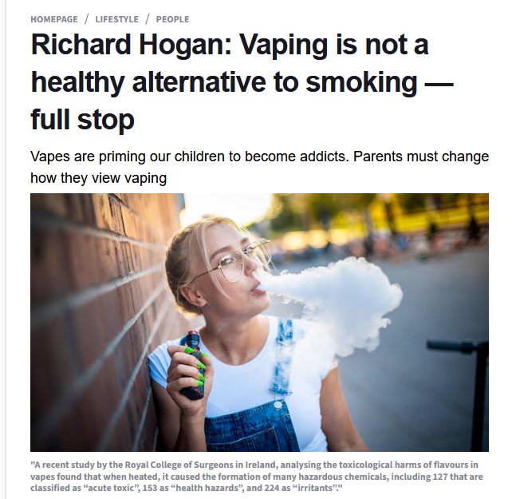
Article
💀 Toxic Chemicals:
When vape flavours are heated, they create 127 “acute toxic”, 153 “health hazard”, and 224 “irritant” chemicals.
🫁 Health Risks:
Vaping is linked to a higher likelihood of smoking uptake, respiratory problems, and mental ill-health according to long-term studies.
🚭 Misleading Safety Perception:
Many parents think “at least it’s not cigarettes,” but vapes still contain high nicotine levels and are marketed toward young people in misleading ways.

Slide 3
Agenda
Intro
Audience
EDA
ML Models
Recommendations

Slide 4

Introduction
Role Play Scenario
Picture this:
You have 24hrs in day:
Which of the following could quietly increase your risk of lung cancer?
Lighting up “just one” cigarette during stress breaks 🚬
Ignoring that dry cough that’s lasted for weeks 🤧
Working in a dusty or smoky environment without a mask 🏭
Thinking “I’m healthy, so I don’t need a check-up”, always fatigue all the time.🙈
I always coughing and short of breath everytime I do normal things🌫️

Slide 5
Introduction
Main Point?
What key features or habits do you notice that contribute to having a chance of detecting lung cancer - and how can we recognize when they start to negatively affect us?
Quiz:
Lighting up “just one” cigarette during stress breaks 🚬
Ignoring that dry cough that’s lasted for weeks 🤧
Working in a dusty or smoky environment without a mask 🏭
Thinking “I’m healthy, so I don’t need a check-up”, always fatigue all the time.🙈
E. I always coughing and short of breath everytime I do normal things🌫️
Are these everyday habits signs of high cancer risk, or
are they just low-risk routines we’ve normalised?

Slide 6

Audience
Stakeholder: World Health Organisation
Public Global Health Agencies
Increasing demand for early and accurate lung cancer diagnosis.
Integration of AI-assisted diagnostic tools to enhance accuracy and reduce human error.
Build confidence in machine learning outputs for informed decision-making.
Communicate AI-generated results transparently and ethically to patients.

Slide 7
Audience
Why this problem worth investigating?
🫁 Lung cancer remains one of the leading causes of death worldwide, often detected only in its late stages when treatment options are limited.
🔬 Early detection can drastically improve survival rates, yet many patients are diagnosed too late due to limited screening and subtle early symptoms.
💻 AI-powered detection tools can help radiologists identify cancer patterns faster and more accurately from X-rays or CT scans.
📊 Data-driven analysis of patient and imaging data enables more reliable predictions and reduces diagnostic errors.
🌍 Social and healthcare impact: advancing detection technology supports global health goals, saves lives, and reduces the burden on healthcare systems.

Slide 8
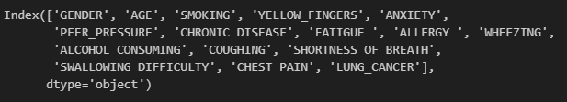
EDA
309 records | 15 features 🧠 Goal: Predict “Lung Cancer Risk” based on 15 lifestyle, health, and symptom features — whether a person is likely to develop lung cancer.

Slide 9

ML Models

Slide 10
ML Models - Baselines

Slide 11
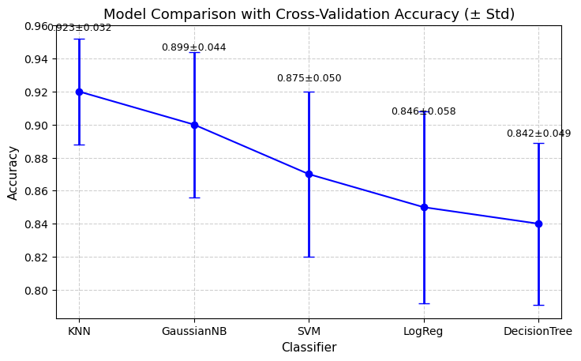
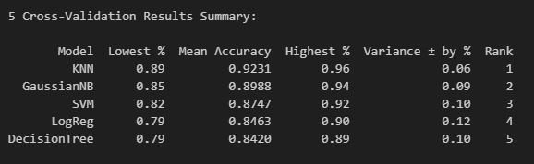
ML Models - Baselines
1. 5-Fold Cross Validation

Slide 12
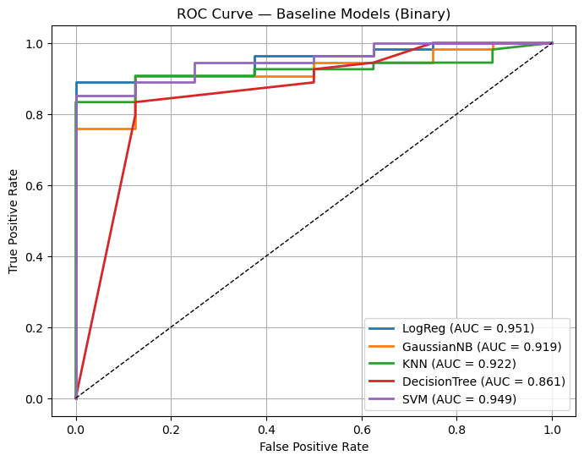
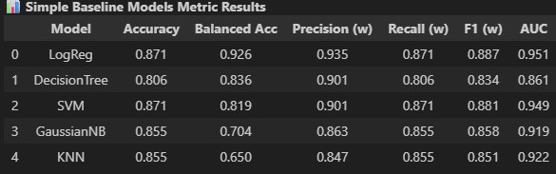
ML Models - Baselines
2. ROC Curve and AUC Comparison
Highest AUC Score: Logistic Regression Regression (0.951)

Slide 13
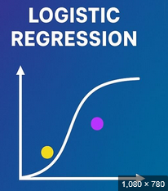
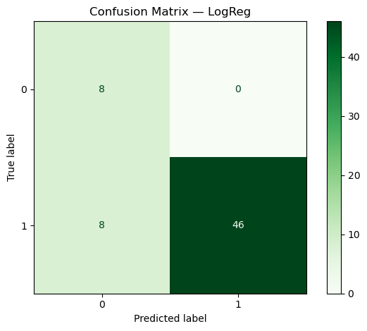
ML Models - Baselines
3. Logistic Regression Confusion Matrix Results
 | Predicted: No Cancer (0) | Predicted: Cancer (1)
Actual: No Cancer (0) | 8 ✅ (True Negatives) | 0 ❌ (False Positives)
Actual: Cancer (1) | 8 ❌ (False Negatives) | 46 ✅ (True Positives)
✅ The Logistic Regression model achieved 85% recall, correctly identifying most cancer cases.
🚫 No false positives were found (100% precision), showing strong reliability when it predicts “Cancer.”
⚠️ However, 8 cancer cases were missed (false negatives), suggesting sensitivity could still improve.

Slide 14
ML Models - Baselines
Best Model - Metrics Summary
Best Model: Logistic Regression
Summarized key metrics to help understand:
AUC 0.951 (Excellent) — AUC measures how well the model separates cancer from non-cancer cases. A perfect model = 1.0, random guessing = 0.5.
The model successfully caught about 85% (recall) of all real cancer cases.

Slide 15
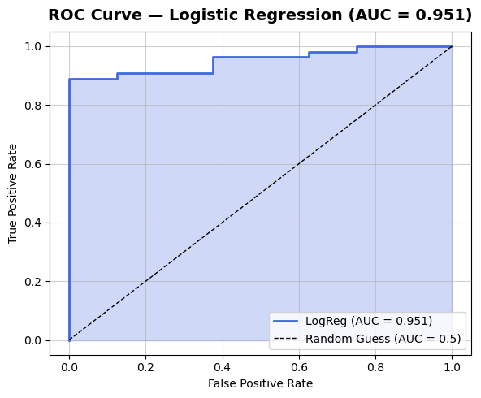
ML Models - Baselines
Best Model - Metrics Summary
Logistic Regression:
Summarized key metrics to help understand:
AUC 0.951 (Excellent) — AUC measures how well the model separates cancer from non-cancer cases. A perfect model = 1.0, random guessing = 0.5.

Slide 16
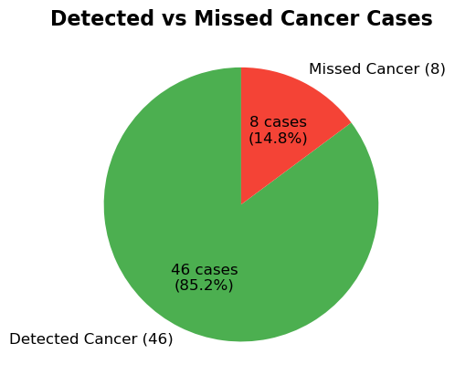
ML Models - Baselines
Best Model - Metrics Summary
Logistic Regression:
Summarized key metrics to help understand:
The model successfully caught about 85% (recall) of all real cancer cases.

Slide 17
ML Models - Ensembles

Slide 18
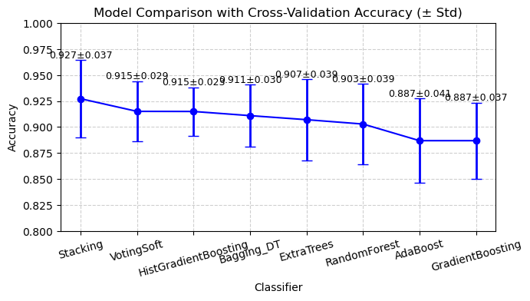
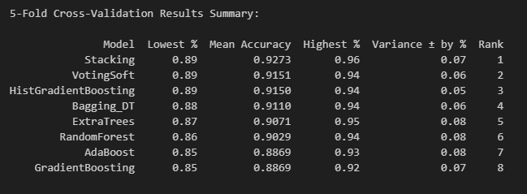
ML Models -Ensemble
1. 5-Fold Cross Validation

Slide 19
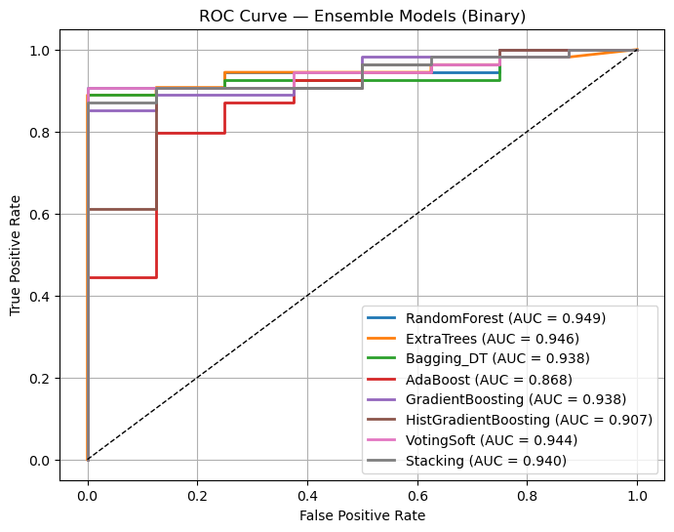
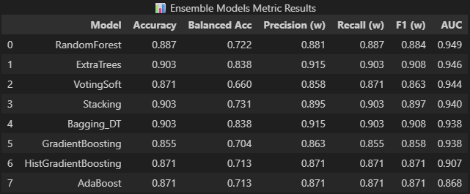
ML Models -Ensemble
2. ROC Curve and AUC Comparison
Highest AUC Score: RandomForest (0.949)

Slide 20
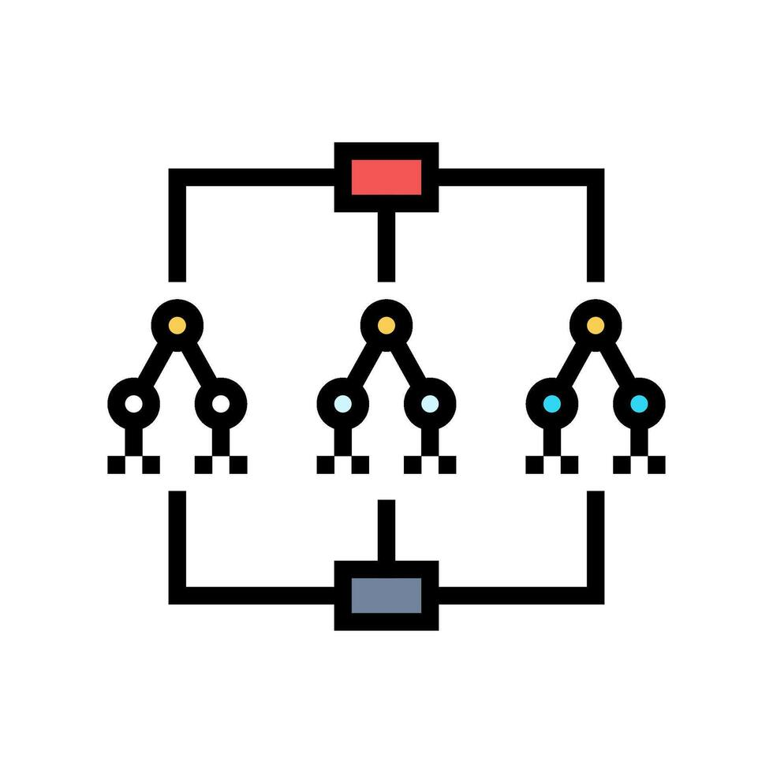
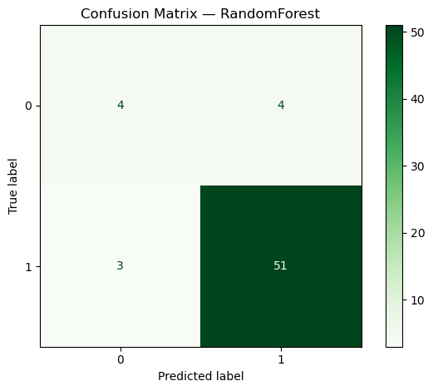
ML Models -Ensemble
3. RandomForest Confusion Matrix Results
 | Predicted: No Cancer (0) | Predicted: Cancer (1)
Actual: No Cancer (0) | 4 ✅ (True Negatives) | 4 ❌ (False Positives)
Actual: Cancer (1) | 3 ❌ (False Negatives) | 51 ✅ (True Positives)
✅ The RandomForest model achieved 94% recall, correctly identifying most cancer cases.
🚫 4 false positives were found (93% precision), showing strong reliability when it predicts “Cancer.”
⚠️ However, 3 cancer cases were missed (false negatives), suggesting sensitivity could still improve.

Slide 21
ML Models -Ensemble
Best Model - Metrics Summary
Best Model: RandomForest
Summarized key metrics to help understand:
AUC 0.949 (Excellent) — AUC measures how well the model separates cancer from non-cancer cases. A perfect model = 1.0, random guessing = 0.5.
The model successfully caught about 94% (recall) of all real cancer cases.

Slide 22
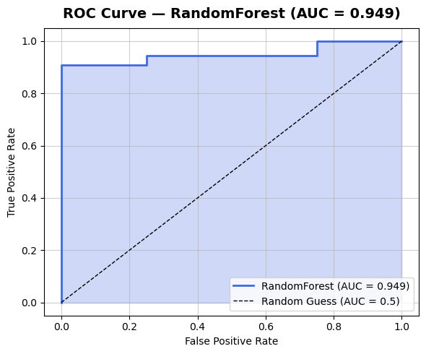
ML Models -Ensemble
Best Model - Metrics Summary
Best Model: RandomForest
Summarized key metrics to help understand:
AUC 0.949 (Excellent) — AUC measures how well the model separates cancer from non-cancer cases. A perfect model = 1.0, random guessing = 0.5.

Slide 23
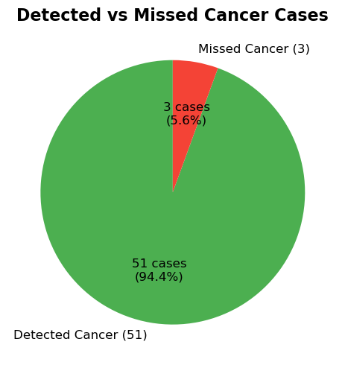
ML Models -Ensemble
Best Model - Metrics Summary
Best Model: RandomForest
Summarized key metrics to help understand:
The model successfully caught about 94% (recall) of all real cancer cases.

Slide 24
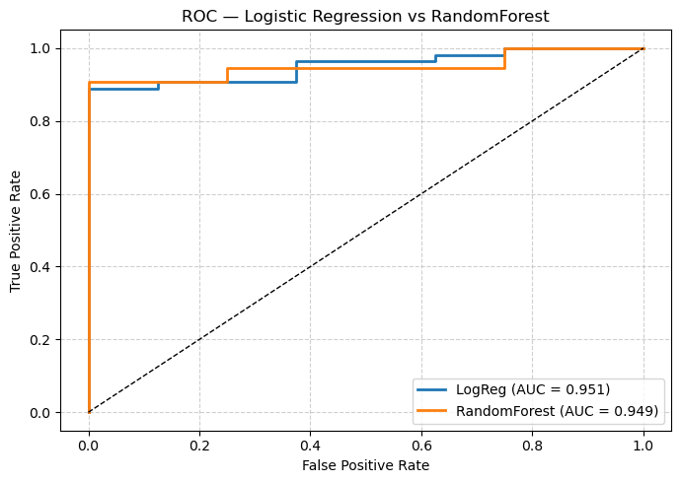
ML Models – Baseline vs Ensemble
Who wins? - Metrics Summary
🏆 Winner: Logistic Regression
Type of Model | Model | F1 | AUC
Baseline | Logistic Regression | 0.887 | 0.951
Ensemble | RandomForest | 0.884 | 0.949

Slide 25
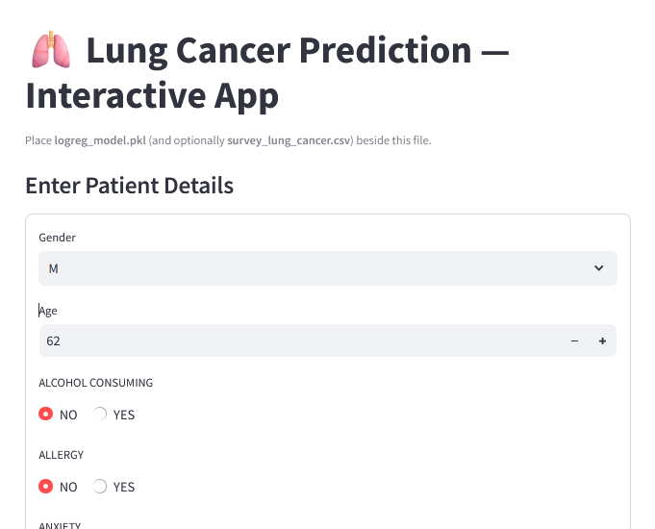
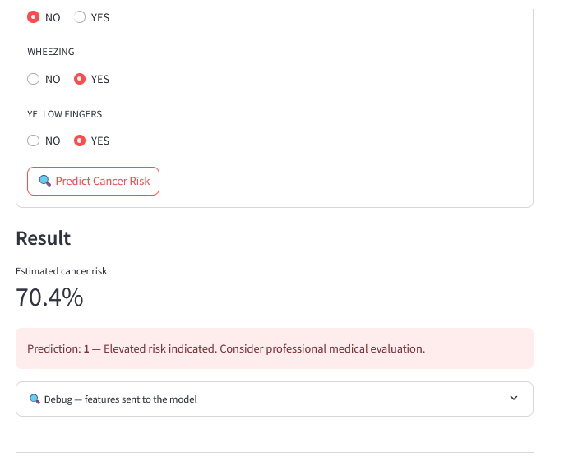
UI Application Showcase

Slide 26
Recommendations
Recommendations Agenda
1. Model Impact
2. Why it matters
3. Stakeholder Action Plan
4. Future Improvements & Limitations Awareness

Slide 27

Recommendations
Model Impact
Model Impact — Logistic Regression for Lung Cancer Prediction
Enables early risk detection from simple patient data.
Provides transparent, interpretable outputs for clinical trust.
Helps prioritize screenings and allocate healthcare resources efficiently.
Scales globally, supporting AI-assisted preventive care in developing regions.
Drives data-informed public health policy for WHO and national programs.

Slide 28

Recommendations
Why this matters?
🌍 Real-World Importance
Early screening of high-risk individuals can cut mortality by over 20 %, yet access to predictive tools remains limited globally. (Journal of Thoracic Oncology, 2024)
This AI model identifies high-risk patients early, even before symptoms appear, supporting faster intervention and saving thousands of lives.
By analyzing everyday health data (e.g., smoking, coughing, fatigue, chest pain), it delivers fast, data-driven risk predictions that help clinicians act sooner.

Slide 29

Recommendations
Why this matters?
⚠️ What Happens If We Don’t Implement It?
Late Detection = Higher Deaths
Over 50% of lung cancer cases are diagnosed at Stage IV, when survival rates drop to ~5%.
In contrast, Stage I cases have a ~65% five-year survival rate — meaning early detection can literally save lives.
Healthcare Systems Overloaded
Late-stage cases require intensive hospital care, increasing workload and burnout among healthcare professionals.
Without AI triage or prediction, diagnostic delays continue to rise globally.

Slide 30
Recommendations
Stakeholder Plan
World Health Organisation
Action 1: Policy and Global Coordination
The model provides standardized, evidence-based screening metrics that can guide WHO’s global lung cancer detection policies.
Action 2: Technology Model Integration
Deploy the AI model as part of WHO lung cancer detection system.
Collaborate existing professionals e.g. ML Engineers, Doctors etc to fine tune model and better diagnosis.

Slide 31

Recommendations
Future Improvements
Improvements suggestions:
Enhance the UI application to highlight which features or variables most influence cancer risk predictions, improving interpretability for users.
Implement feature engineering and correlation analysis to identify and display the strongest predictive factors, rather than leaving users uncertain about which variables have the greatest impact.

Slide 32

Recommendations
Limitations
Limitation Awareness:
Model interpretability remains limited — users can’t see which variables impact predictions most.
Dataset may be biased or too small to generalize across global populations.
Further medical validation is needed to confirm clinical reliability.
Integration with hospital systems and WHO frameworks may face technical and ethical barriers.

Slide 33

Questions?

